Slide 1
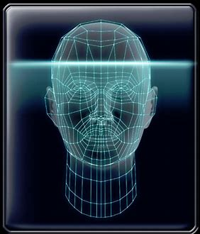
Facial Recognition Neural Network Algorithm Discussion – Week 10
IST707
Professor Lin
By: Brian Hogan

Slide 2
“The technology with the greatest potential to change policing is also the least visible to the public”
-The Economist May 25th 2019
Situation: Deep convolutional neural networks didn’t exist 5 years ago and contribute meaningfully in both facial and image recognition technology
Overall Advantages** | Overall Disadvantages*
Industrial revolution in accuracy has been achieved | Crime rarer than 1990s; tech. skepticism is growing
20 times faster searching databases & finding matches | Algorithms not confirmed across all race & age groups
0.2% error rate 12.3 million individuals portraits | Weariness of using technology to monitor citizens
Algorithm quality, across applications, not universal | Possess unique threat to civil rights & liberties
Algorithms outperforming 2014 technology | “Technology exists…best thing…is to help shape it…”
Miscellaneous In active development in private industry for sale, such as Amazon’s “Rekognition”* Actively being evaluated by U.S. government for standards, concerns, and cause & effect social research***
*References: Editor (2019). Files, Not Faces. The Economist Magazine. May 25th 2019, pg27. (details last slide)
**Chapellent-Lanier, T. (2018). Facial recognition algorithms are getting a lot better, NIST study finds.
Retrieved from: https://www.fedscoop.com/facial-recognition-algorithms-getting-lot-better-nist-study-finds/
***Grother, P., Ngan, M., Hanaoka, K. Ongoing Face Recognition Vendor Test (FRVT) Part 2: Identiﬁcation. National Institute of Standards and Technology.

Slide 3
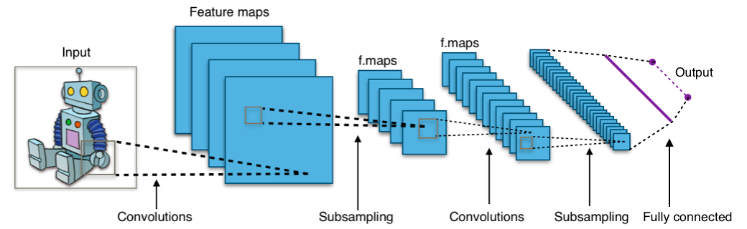
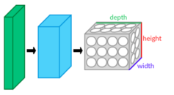

A convolutional neural network (CNN) is a class of deep neural networks, most commonly applied to analyzing visual imagery. CNNs are regularized versions of multilayer perceptrons (input layer, hidden layer, output layer) where neurons in one layer are connected to neurons in the next. Inter-connectedness makes models prone to data overfitting. CNN enables scientists to assemble complex patterns into smaller simpler patterns. Algorithm inspired by animal species visual cortex in 1990s.*
(a (process below)) Convolution layer: tensor inputs (i.e. a math array object) ==> (image) x (width x height) x (depth). Layers have learning filters called kernels that compute dot producing 2-d maps (neurons) who iterate and learn features of spatial position inputs.
(b) Neurons (layer outputs) are filters along a depth dimension of a small input used to connect between tensor input feature maps. Neuron connectivity between layers becomes a hyperparameter (receptive field) whose (width x height) extend depth wise. The algorithm’s “…architecture ensures learnt filters produce a strong response to spatially local input pattern(s).”
(c) Algorithm iterates… feature maps & convolutions generating: depth, stride, and zero-padding. Depth controls # layer neurons connecting a region based on learned edges, such as blobs of color. (d) Stride controls how depth columns of (width x height) are allocated by adjusting pixels until resulting output volume has smaller spatial dimensions. Zero-padding are zero(0) input values applied to input volume borders to help control the output of volume spatial size.
(e) A fully-connected state are neurons across layers in a flat matrix adjusted with weights & bias vectors from learning iterations
(f) Formula: neuron fit: function of input volume size (W), the kernel size in convolution (K), stride applied (S) + zero-padding (P)
a
# neurons to fit a volume
e
c
d
f
b
*References: Wikipedia (details next slide)

Slide 4
References & Packages
References
Editor (2019). Files, Not Faces. The Economist Magazine. May 25th 2019, pg27.
Chapellent-Lanier, T. (2018). Facial recognition algorithms are getting a lot better, NIST study finds. Retrieved from: https://www.fedscoop.com/facial-recognition-algorithms-getting-lot-better-nist-study-finds/
Grother, P., Ngan, M., Hanaoka, K. Ongoing Face Recognition Vendor Test (FRVT) Part 2: Identiﬁcation. National Institute of Standards and Technology. U.S. Department of Commerce. Retrieved from: https://nvlpubs.nist.gov/nistpubs/ir/2018/NIST.IR.8238.pdf
Editor(s) (2019). Convolutional Neural Network. https://en.wikipedia.org/wiki/Convolutional_neural_network. Wikipedia Foundation
Packages: (note: R has some packages available but not fully implement and many algorithms built in C++)
MXNet, Keras, & Tensorflow

